Slide 1


CS-446: Information Systems Security
Lecture # 13: Email Sender Authentication
Prof. Dr. Sufian Hameed
Department of Computer Science
FAST-NUCES

Slide 2
Overview
Intro to Email and SMTP
Sender Authentication Problem
Email Sender Authentication Standards
Sender Policy Framework (SPF)
SenderID
Domain Key Identified Mail (DKIM)
Improvements

Slide 3
Electronic Mail
Email or Electronic mail is the biggest service being used over the Internet today.
44 – Years since the first email was sent, in 1971.
The de facto standard for e-mail transmissions across the Internet is Simple Mail Transfer Protocol (SMTP).
SMTP is defined in RFC 821 and it is a relatively simple, text-based protocol.
Not entirely secure thus vulnerable to SPAM.

Slide 4
Email Statistics
In 2010
107 trillion – The number of emails sent on the Internet.
294 billion – Avg. number of email messages per day.
1.88 billion – The number of email users worldwide.
480 million – New email users since the year before.
89.1% – The share of emails that were spam.
262 billion – The number of spam emails per day (assuming 89% are spam).
*royal.pingdom.com

Slide 5
Email Statistics
In 2011
3.146 billion – The number of email accounts worldwide.
25% – Share of email accounts that are corporate.
27.6% – Microsoft Outlook was the most popular email client.
19% – Percentage of spam emails delivered to corporate email inboxes despite spam filters.
112 – Number of emails sent and received per day by the average corporate user.
425 million – Total number of Gmail users (largest email service in the world as of June 2012).
$44.25 – The estimated return on $1 invested in email marketing in 2011.
*royal.pingdom.com

Slide 6
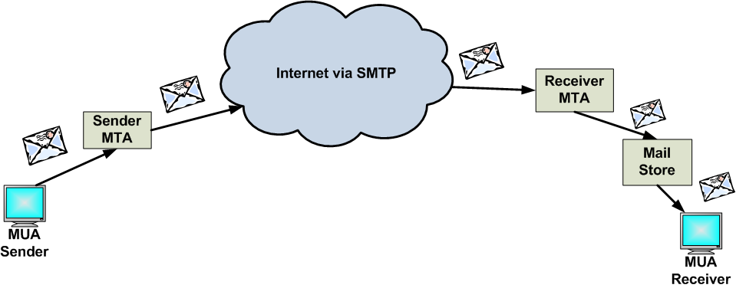
Basic SMTP Architecture
SMTP clients and servers have two main components
Mail User Agent (MUA) – Prepares the message, encloses it in an envelope (ex. MS-Outlook, Thunderbird).
Mail Transfer Agent (MTA) – Transfers the mail across the internet (ex. Sendmail, Exim).

Slide 7
Basic SMTP Commands
HELO/ELHO: sender’s host domain name
VRFY: name to be verified
MAIL FROM: email address of sender
RCPT TO: email of Indented recipient
DATA: header and body of message
QUIT:

Slide 8
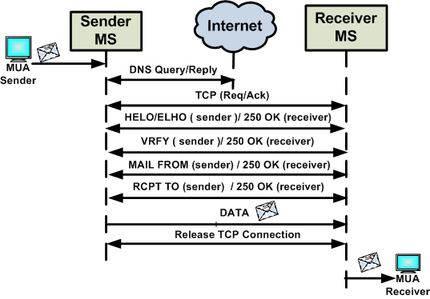
How SMTP Works

Slide 9
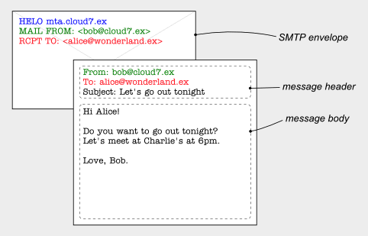
Format of an Email
Consists of two parts
SMTP Envelope
Data
Header
Body

Slide 10
Limitations of SMTP
SMTP is continuously evolving, but when it was designed, in the early 1980s, there was no cause to consider security.
The original SMTP specification did not include a facility for authentication of senders, making SMTP vulnerable to From address forgery.
Modifying SMTP extensively, or replacing it completely, is not believed to be practical, due to the network effects of the huge installed base of SMTP.

Slide 11
Email Spam
Spam
Spam emails is still an open problem largely outnumbering legitimate ones.
In 2010, 89% of the emails were spams (262 billion spam messages daily) [1].
Projections show that spam will incur a cost of $338 billion by 2013 [2].
Why Spam works
Use exploited MTAs (i.e., botnets) and with forged From: addresses.
88.2% of the total spam are sent by botnets using forged addresses (Symantec 2010).
No or marginal infrastructural cost.
No ownership, spammer remains anonymous, hence no action legal action possible.

Slide 12
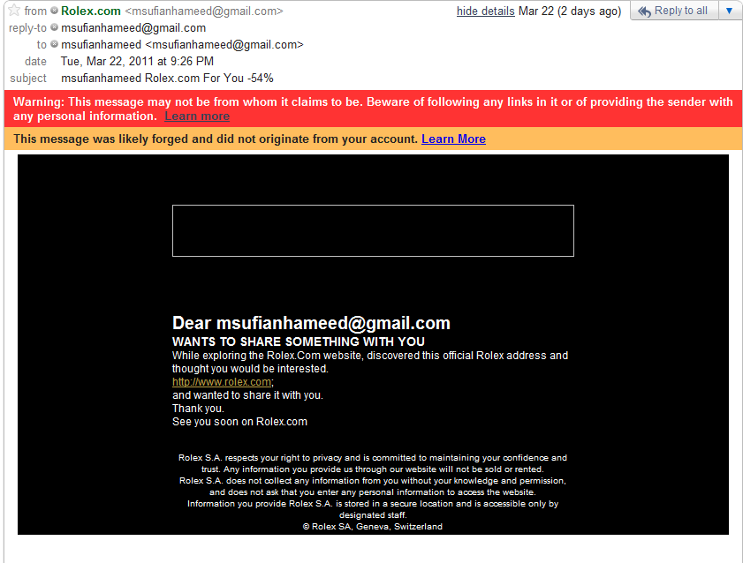

Slide 13





Sender Authentication
Sender Authentication
Enabled
Industry Standards
AOL -- Sender Policy Framework (SPF) --- started in mid 2005
Hotmail/MSN – SenderID --- started in 2006
Yahoo – Domain Key Identified Mail (DKIM) --- started in 2006
Internet
Gmail.com
TO:abc@yahoo.com
From: xyz@gmail.com
Yahoo.com
TO:abc@yahoo.com
From: xyz@gmail.com
Spammer

Slide 14
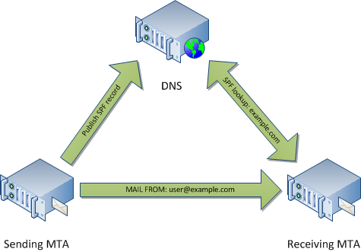
Sender Policy Framework (SPF)
SPF is an IP-based sender authentication
Operates on SMTP Envelope
Allows domain admins to publish IP(s) for their valid servers as SPF record
The receiving side can query the DNS to validate the senders’ IP
Most Adopted (60% of prominent domains)

Slide 15
Sender Policy Framework (SPF)
Sample SPF
spf-a.hotmail.com text "v=spf1 ip4:209.240.192.0/19 ip4:65.52.0.0/14 ip4:131.107.0.0/16 ip4:157.54.0.0/15 ip4:157.56.0.0/14 ip4:157.60.0.0/16 ip4:167.220.0.0/16 ip4:204.79.135.0/24 ip4:204.79.188.0/24 ip4:204.79.252.0/24 ip4:207.46.0.0/16 ip4:199.2.137.0/24„
SPF validation results
Pass – the host is authorized by the domain to send its e-mail.
Fail – the domain forbids the host to send its e-mail.
Neutral – the domain owner explicitly states that they cannot or do not want to assert whether the IP is authorized or not.
None – no SPF record found or no checkable sender’s domain found.

Slide 16
Sender Policy Framework (SPF)
Problems:
SPF is also easily adopted by Spammers.
20% of Spamming domains already adopted SPF.
5% of legitimate messages can potentially fail SPF test.
Message forwarding is also a limitation.

Slide 17
SenderID
Heavily based on SPF, with only a few additions.
Receiving MTA validates the Purported Responsible Address (PRA) i.e the From Address in the message header.
Validation is not at the SMTP time
Published record is almost identical to SPF, except
v=spf1 is replaced by spf2.0/mfrom, spf2.0/mfrom,pra or spf2.0/pra,mfrom OR spf2.0/pra

Slide 18
Domain Key Identified Mail (DKIM)
Header Based Approach (don't work at SMTP time)
Defines a domain level digital signature authentication
MTAs sign all the outbound mail (email header, body, etc)
Use Public key cryptography
DNS are used as key server technology (public keys are publish on the DNS). Receiver query the DNS for public key to verify the signature.

Slide 19
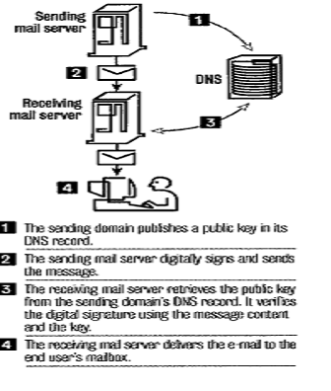
Domain Key Identified Mail (DKIM)
* Via DKIM.org

Slide 20
Domain Key Identified Mail (DKIM)
DKIM-Signature: a=rsa-sha1; q=dns;
d=example.com;
i=user@eng.example.com;
s=jun2005.eng; c=relaxed/simple;
t=1117574938; x=1118006938;
h=from:to:subject:date;
b=dzdVyOfAKCdLXdJOc9G2q8LoXSlEniSb
av+yuU4zGeeruD00lszZVoG4ZHRNiYzR
Problems:
Spam Transmission: signature can only be validated after the entire message content is received
Prone to content munging (common problem with lists)
Spammer can also adopt it to sign their messages

Slide 21
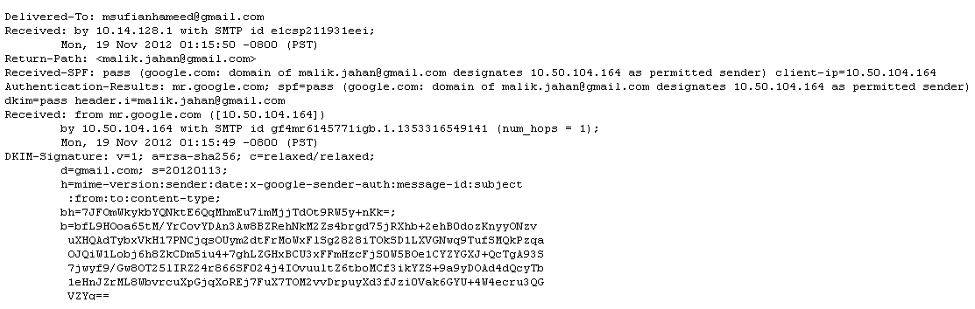
Example of SPF and DKIM

Slide 22
Required Improvements
Email Sender Authentication at the SMTP time.
Bind the identity of the domain owner to its domain and make it hard for the spammer to adopt iSATS

Slide 23
iSATS: Leveraging Identity based Email Sender Authentication for Spam Mitigation
Crypto based sender authentication
Leverages Identity-based signature (IBS) under Identity-based cryptography (IBC)
IBC saves the burden of PKI required for managing and distributing public keys
Required establishment of Trusted Authority (TA) also called Public Key Generator (PKG)
PKG issues Secret Key (SK) and System Parameters
TA is responsible for verifying the identitiy of a domain before issuing the SK

Slide 24
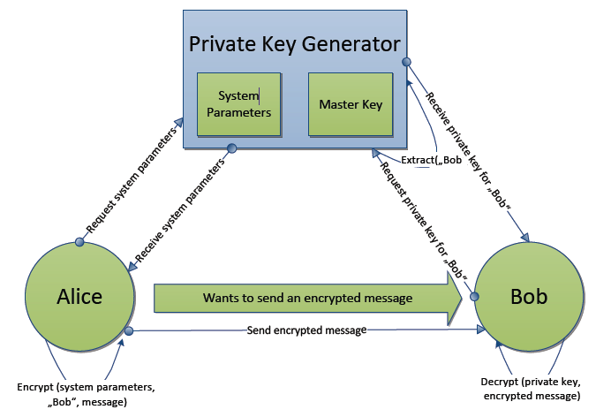
Identity Based Encryption

Slide 25
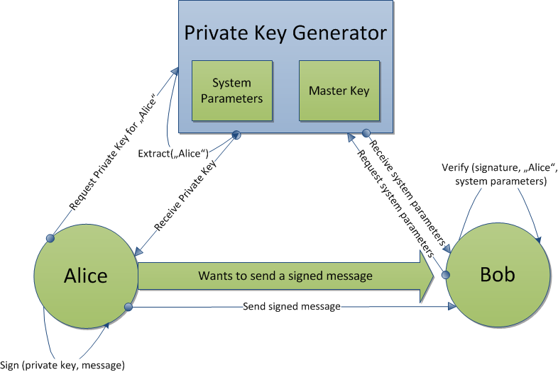
Identity Based Signing

Slide 26
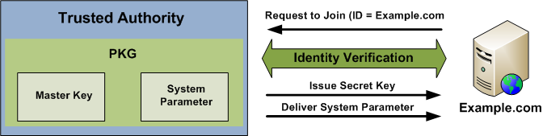
iSATS (Four Functional Steps)
1. Setup
Executed once in the beginning by TA/PKG.
Generated Master Key and System Parameters.
2. Identity Verification and Secret Key Extraction
iSATS is a closed system and domains are not added automatically.
TA verifies the identity of the domain. TA is envisioned to provide extended validation (organizational identity) for domain‘s identity.
TA issues system parameters and SK.

Slide 27
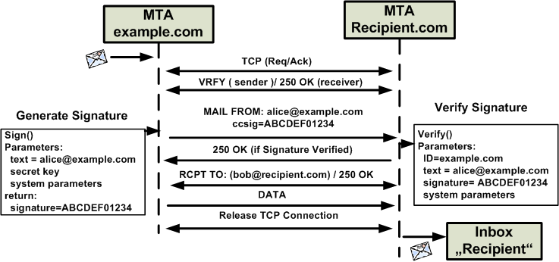
iSATS (Four Functional Steps)
3. Signature Generation
4. Signature Varification

Slide 28
Prototype
The basic prototype implementation includes:
Server Implemention for TA
System setup
Extraction and distribution of SK
iSATS based email processing
Signature generation and verification
The prototype utilized
Cha-Cheon IBS scheme (pairing based cryptography)
Mail Avenger (SMTP Daemon)
Postfix (MTA)

Slide 29
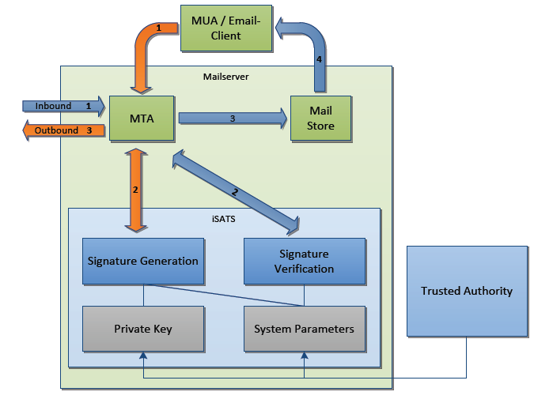
Prototype Architecture

Slide 30
Evaluation
Potential bottlenecks of iSATS are computionally expensive tasks like:
Signature Generation
Signature Verification
Extraction of SKs
Analyzed the above key functionalities on systems with varying computational specs as follows
Workstation: 2 GHz intel core2duo, 3 GB RAM
Netbook: 1.6 GHz intel Atom, 1 GB RAM
Virtual Machine: 2.4 GHz quad-core, 256 MB RAM

Slide 31
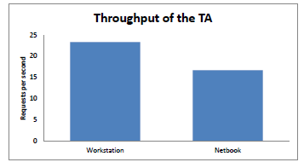
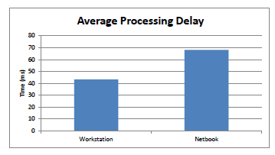
Performance of TA in SK Extraction

Slide 32
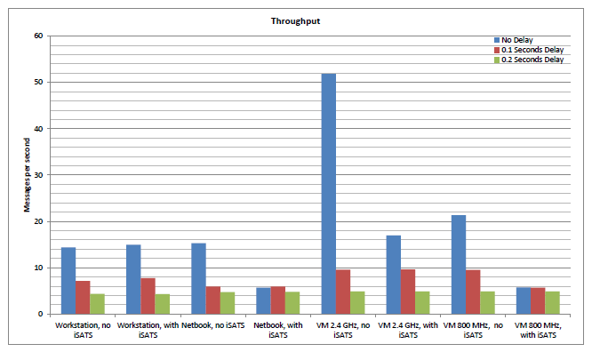
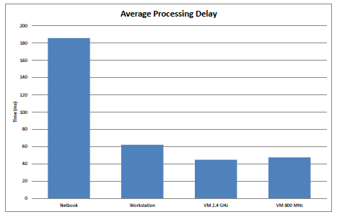
Performance of Email Processing with iSATS

Slide 33
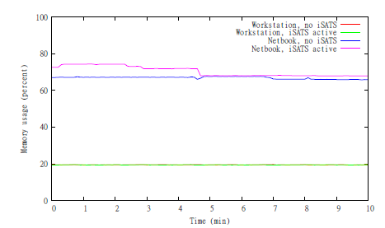
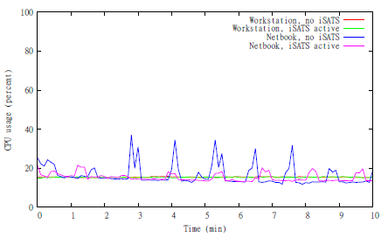
Memory and CPU Usage

Slide 34
Conclusion
iSATS is a new email sender authentication scheme based on Identity based cryptography .
iSATS forms a closed system that provide reliable and easy ways to bind identity of a legitimate sender.
It is hard for the spammer to adopt the system without getting noticed.

Slide 35
References
1. http://royal.pingdom.com/2011/01/19/email-spam-statistics/
2. http://www.redcondor.com/company/

